Slide 1


STUDENT ID:- 16101044.
Doctors Database Management System.
SUPERVISOR:
ASIFUL HOSSAIN.
OMAR SUNNY.

Slide 2
Table of Contents:-
Introduction
Application
Feature
Platform
Demo
Code Snippet
Trouble Shooting
Future Work
Conclusion

Slide 3


Introduction:-
C and Advance C
Structure
FILE
Pointer

Slide 4
Doctors Personal Information.
Types of Specialist
Experienced & Youngest Doctors.
Contract Information.
Level & Institute.
Application:-

Slide 5
FEATURE:-
Doctors Profile
Increase Efficiency
Strong Security
Save the Time
Easy Access

Slide 6
Platform:-
Database:- FILE
Language:- C++
Compiler:- Code Blocks
Version:- 16.01

Slide 7
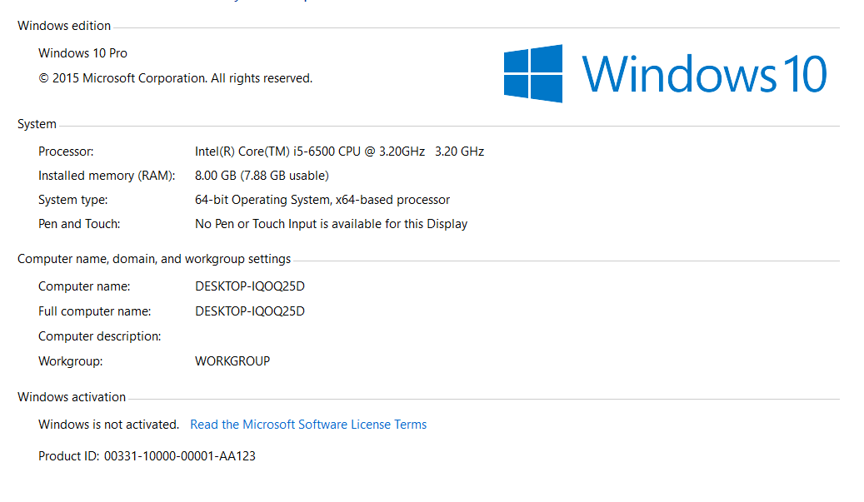
PC Configuration:-

Slide 8
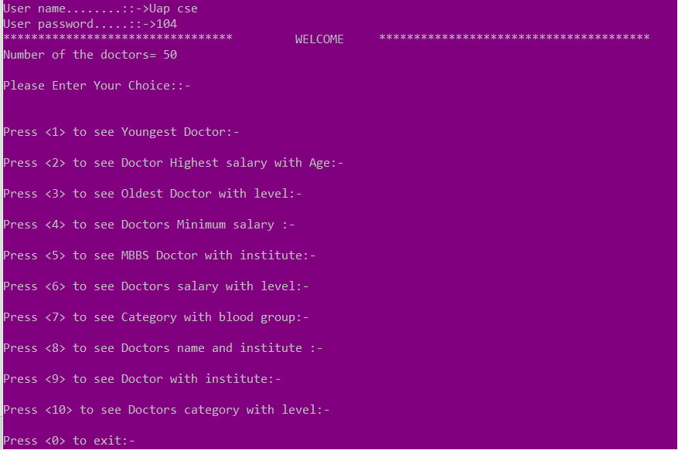
Project Demo:-

Slide 9
Code Snippet:-
Enter the .cpp file.

Slide 10
Trouble Shooting:-
Debug Window Problem
Garbage Value
Input problem
Text File Problem

Slide 11
Future Work:-
Developed the Project in future:-
By Using Java.
By Using Web Page.
By Using Graphics Designing.
By Using Database Design.

Slide 12
Conclusion:-
Easy Access.
Save Data inside the System.
No Danger & Obstacles from external entities.
Useful to A Hospital.

Slide 13
Printf(“Thank You”);

